Slide 1

Department of Mathematics & Computer Applications
PROJECT TITLE:
“Real Time Smart Traffic System ”
Under The Guidance Of Dr. Amit Bhagat
Submitted by:
Sachin Kumar(162120040)

Slide 2
INTRODUCTION
The idea behind this System is to provide the smart traffic system using machine learning (object detection).This System provides smart solution for traffic system. Using this system we can optimize traffic light timing in real time . Real Time Smart Traffic System is a machine which is used to make traffic system smart and dynamic .this machine use’s object detection technique for gathering real time traffic data and on the base of these data it perform traffic light management in real time . this machine is very useful to save time on traffic signals . this is generic project which can be used widely for the educational purpose . in this project we try to make automatic traffic light signal more smart we are using some pertained model doing necessary customization and retraining of that model comparing some exiting models for better , faster and accurate results . actually we are just trying to reduce waiting time at traffic signals doing replacement of pre fixed waiting time with real time waiting time according to amount of traffic.

Slide 3
Objectives
Detect type of object.
Detect Coordinate Of each type of object.
Count each type of object
Optimize traffic light .

Slide 4
My Approch
Some Important MODEL used In this project:-
- RetinaNet (Size = 145 mb, high performance and accuracy, with longer detection time)
- YOLOv3 (Size = 237 mb, moderate performance and accuracy, with a moderate detection time)
- TinyYOLOv3 (Size = 34 mb, optimized for speed and moderate performance, with fast detection time)
Technology Used:
Language: Python
IDE : Spyder , Jupyter notebook
Tools : Anaconda, openCv
In this project work we have used several AI & machine learning algorithm and libraries using python
Some of most important libraries is mentioned below
ImageAI
Tensorflow
Numpy
OpenCV
DATA SET USED:- COCOdataset.

Slide 5
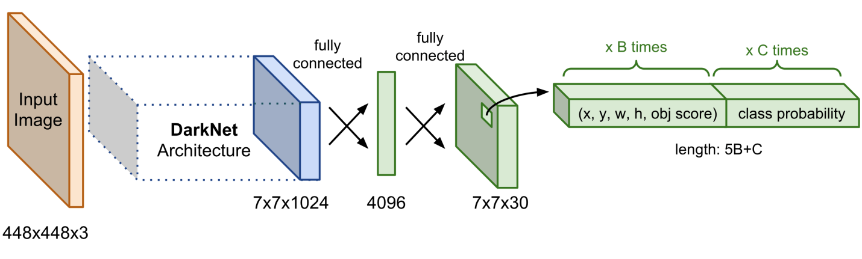
3. Architecture:
COUNTING NUMBER
OF
OBJECTS
OPTIMIZING
TRAFFIC
SIGNALS

Slide 6
What is YOLO?
YOLO (You Only Look Once), is a network for object detection. The object detection task consists in determining the location on the image where certain objects are present, as well as classifying those objects. Previous methods for this, like R-CNN and its variations, used a pipeline to perform this task in multiple steps. This can be slow to run and also hard to optimize, because each individual component must be trained separately. YOLO, does it all with a single neural network.
How It Works
Prior detection systems repurpose classifiers or localizers to perform detection. They apply the model to an image at multiple locations and scales. High scoring regions of the image are considered detections.
We use a totally different approach. We apply a single neural network to the full image. This network divides the image into regions and predicts bounding boxes and probabilities for each region. These bounding boxes are weighted by the predicted probabilities.

Slide 7
KEY FACTOR:-
Detection Speed
Hiding/Showing Object Name and Probability
Input & Output Types
Prediction Classes
Detection Classes
Video and Live-Feed Detection and Analysis
Custom Training and Prediction Classes

Slide 8
Experimental results and discussion:-
Resnet:-
detection speed="normal"
output-->
person : 56.95698261260986
person : 52.8093159198761
person : 70.20384073257446
person : 76.83472633361816
person : 78.70040535926819
bicycle : 79.77726459503174
person : 83.55753421783447
person : 89.4381046295166
truck : 60.933083295822144
person : 69.52639818191528
bus : 98.00646901130676
truck : 83.69434475898743
car : 71.70117497444153
Processing Time 10559.930957999995ms
Yolo:-
detection_speed="normal"
output-->
traffic light : 57.40169882774353
truck : 90.8550500869751
bus : 96.51610255241394
bus : 99.83268976211548
person : 73.49357604980469
person : 89.48697447776794
person : 93.7789797782898
person : 98.92159104347229
person : 99.69530701637268
Processing Time 8559.930957999995ms
detection_speed="flash"
output-->
bus : 92.69177317619324
car : 55.582016706466675
car : 82.91438221931458
person : 50.45552849769592
person : 55.900609493255615
person : 90.95762968063354
Processing Time 3074.106643999999
detection_speed=""flash"
output-->
truck : 51.99494957923889
car : 83.16107988357544
Processing Time5074.106643999999

Slide 9
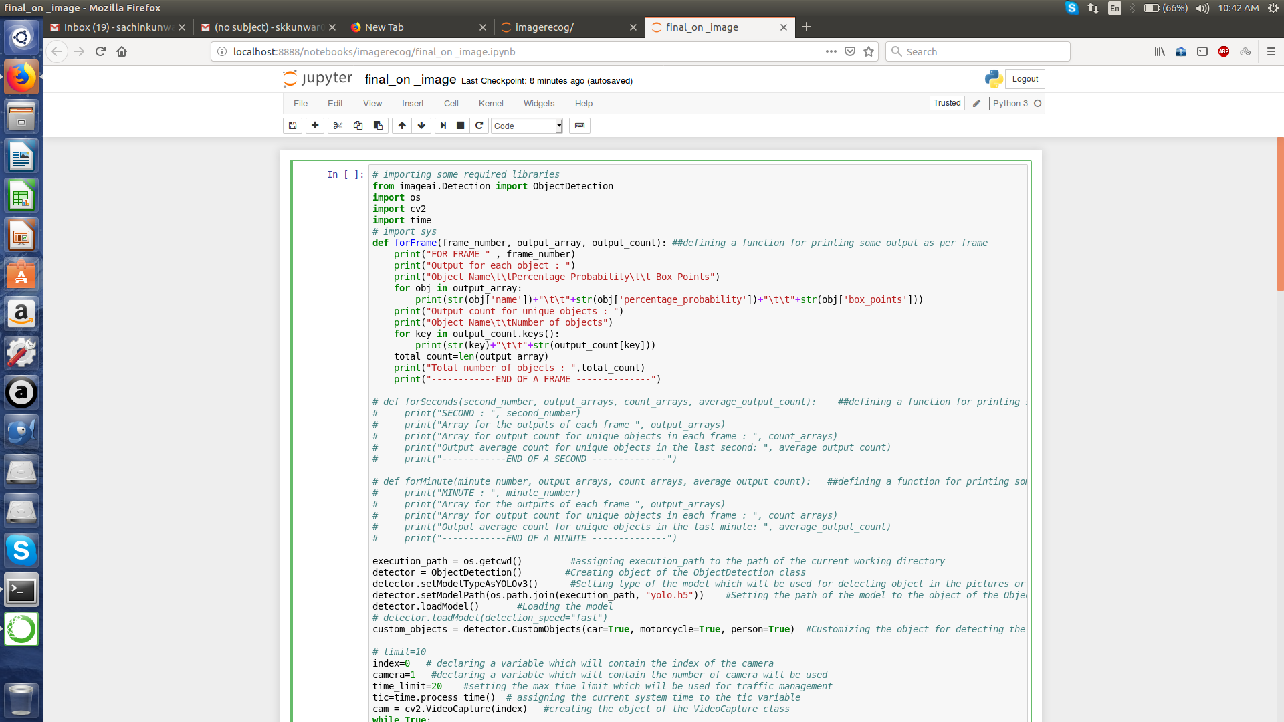

Slide 10
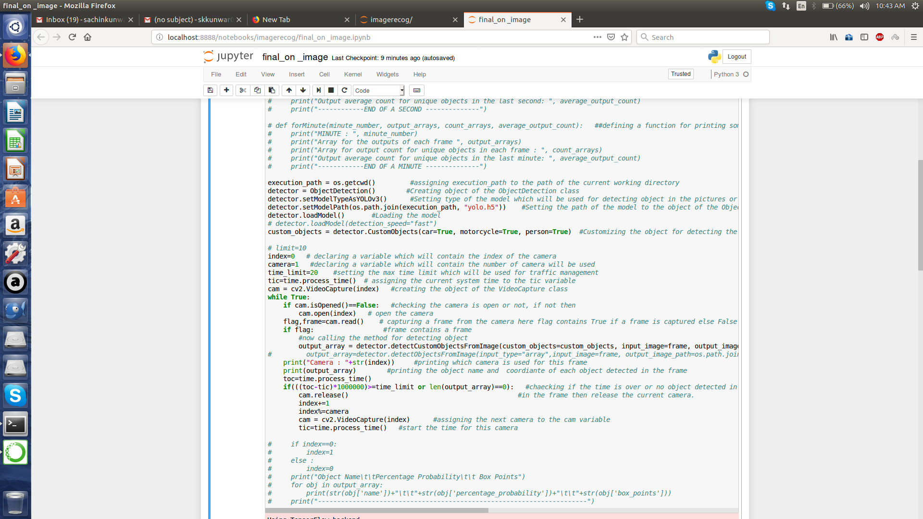

Slide 11
SYSTEM REQUIREMENT
HARDWARE REQUIREMENTS
(1) Processor: Intel Core I7 or above
(2) RAM: 12 GB or above
(3) Hard Disc: 100 GB or above
(4)Digital Camera with Video Recording

Slide 12
SYSTEM REQUIREMENT
SOFTWARE REQUIREMENTS
(1) Technology : Python 3.6 or above
(2) Development Tools: Anaconda, Spyder, Jupyter Notebook

Slide 13

THANK YOU

